Slide 1
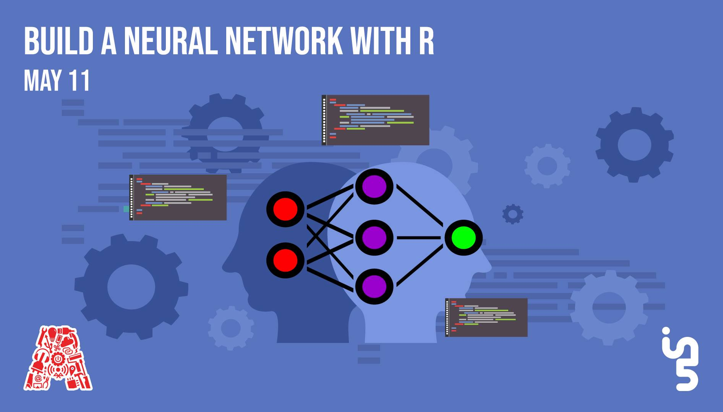

Slide 2
About the Assembly
A smart lab based out of In5 since Dec 2014
Over 250 free workshops done
ASSEMBLY: HACK - Embedded systems, iOT and hardware
ASSEMBLY: CODE - Software projects - APIs, frameworks, apps
Age range: 16-60 - students, professionals, entrepreneurs
Focus on smart technology and practical applications
Forum: members.theassembly.ae

Slide 3
TAG US ON OUR SOCIAL MEDIA
FACEBOOK
TWITTER
INSTAGRAM
YOUTUBE
The Assembly (@MakeSmartThings)
@MakeSmartThings
@MakeSmartThings
The Assembly

Slide 4

Overview
TOPICS:
What Is R and why to use it?
Companies using R
Introduction to R language
Syntax in R
Regression and Curve Fitting
Neural Network in R

Slide 5
Recap
Blockchain with R
Neural Network using TensorFlow in JS
https://github.com/The-Assembly/Blockchain-with-R.git
https://github.com/The-Assembly/IntroToTensorFlowJS.git

Slide 6


What Is ?
STATISTICAL
COMPUTING

Slide 7
Why Use ?
RELATES TO OTHER LANGUAGES
OPEN SOURCE LANGUAGE
CROSS PLATFORM COMPATIBLE
DATA WRANGLING
EXTREMELY COMPREHENSIVE
STATISTICAL LANGUAGE
DATA VISUALIZATION
MACHINE LEARNING

Slide 8

Companies Using
Advertisement, Economic Forecasting and Big-data statistical modeling.
To help create innovative solutions like IBM Watson.
Data Visualization and Semantic Clustering.
Predict re-booking rates.
Exploratory Data and Experimental Analysis, Big-Data Visualization, Human Resources.
User behaviour, Visualizing infrastructure utilization data, Abnormal login detection, Time series anomaly detection, Forecast package.
Data journalism and Data visualization

Slide 9
Getting started
Install: R( https://cran.r-project.org/bin/ ) & RStudio( https://www.rstudio.com/products/rstudio/download/ )
Installing on Ubuntu using terminal
$sudo apt-get install r-base
$sudo apt-get install gdebi-core
3. Ask for help from the Assembly team if you get stuck with anything!

Slide 10
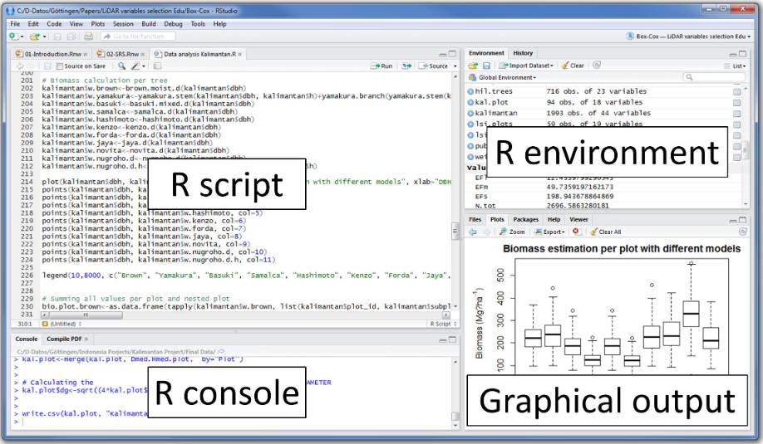
Studio Layout

Slide 11
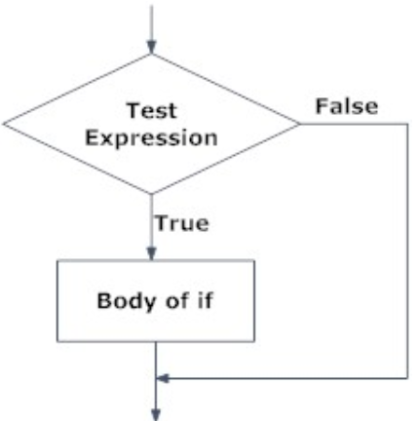
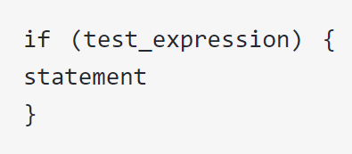
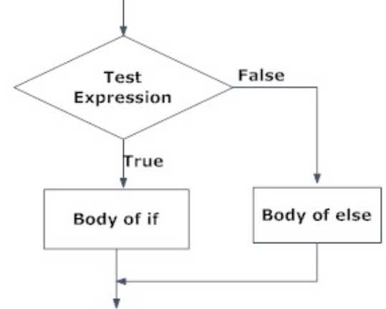
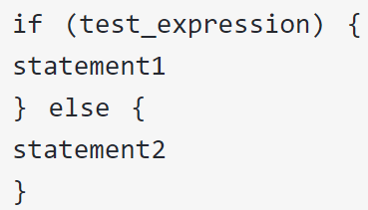
Flow Control
if statement
If…else statement

Slide 12
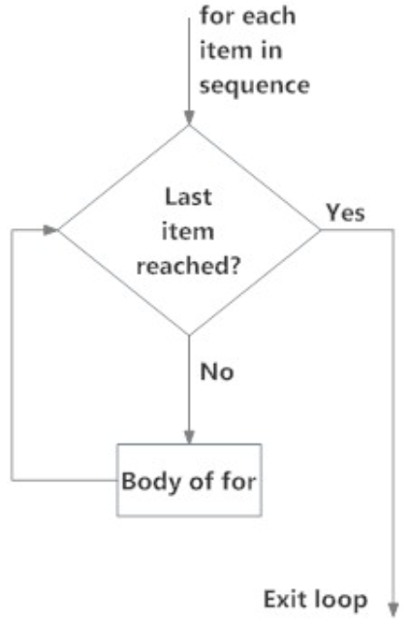
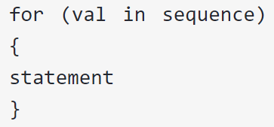
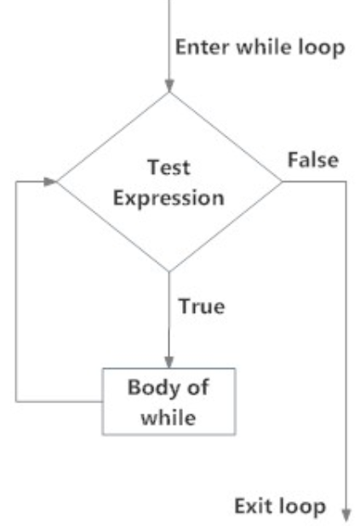
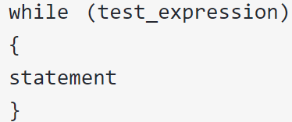
Ifelse() function
for loop
while loop

Slide 13
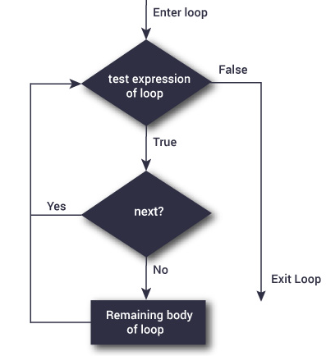
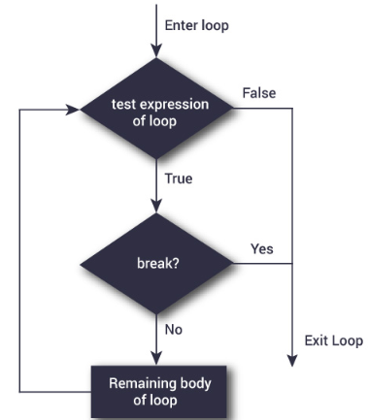
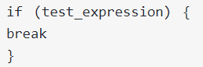
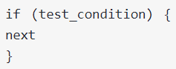
Break and Next Statement

Slide 14
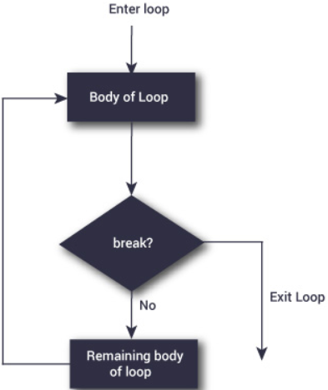
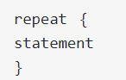
Break and Next Statement

Slide 15
Functions
Defining a function
MyFunction <- function (argument){
#Statement
Return (argument)
}
Calling a function
MyFunction(arg)

Slide 16
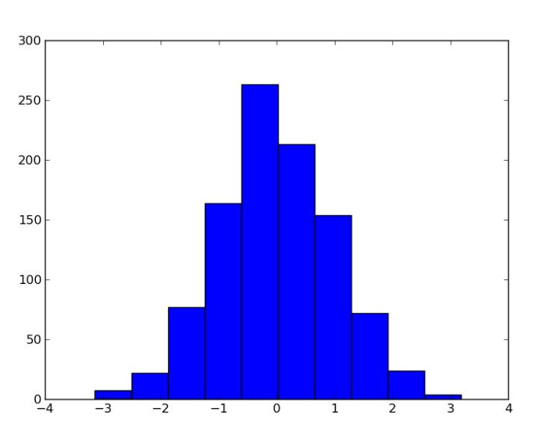
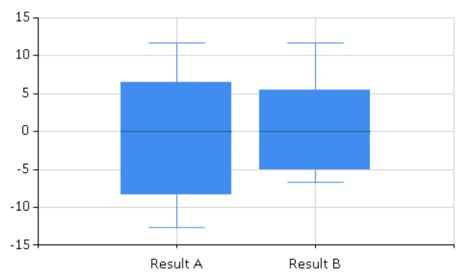
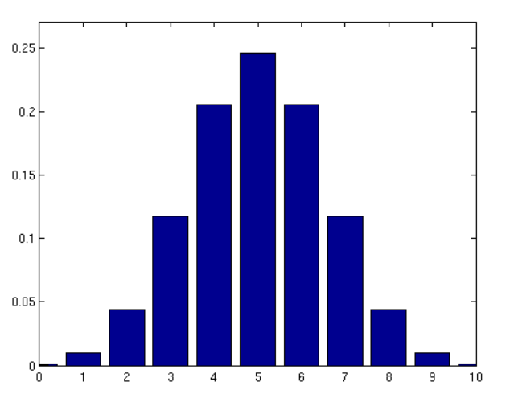
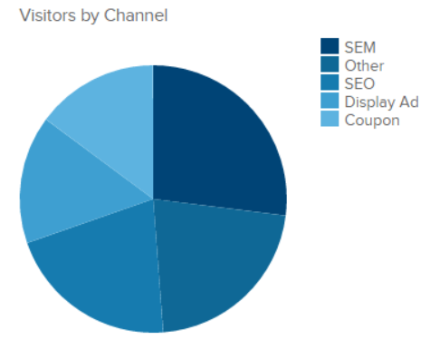
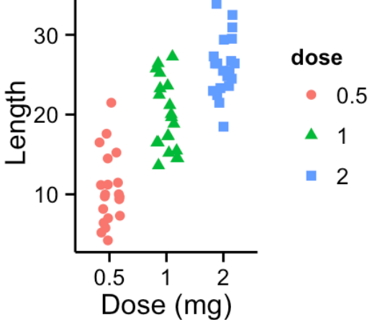
Graphs And Charts
Bar Plot Histogram Pie Chart Box Plot Strip Chart
barplot() hist() pie() boxplot() stripchart()

Slide 17
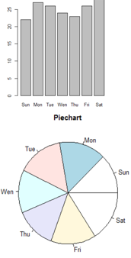
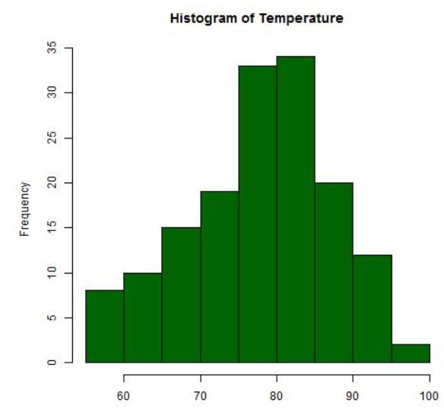
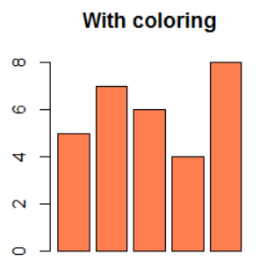
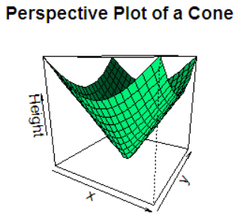
Advance Options
Subplot
Saving Plots
Color Plot
3D Plot
par()
jpeg(),png(),bmp() & tiff()
dev.off()
Col="Name of the color"
persp(x, y, z)

Slide 18
Linear Regression & Curve Fitting
Linear regression is a linear approach to modelling the relationship between a scalar response dependent variable and independent variables.
Curve fitting is the process of constructing a curve, or mathematical function, that has the best fit to a series of data points, possibly subject to constraints.

Slide 19
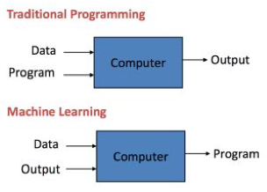
Machine Learning

Slide 20

Machine Learning

Slide 21
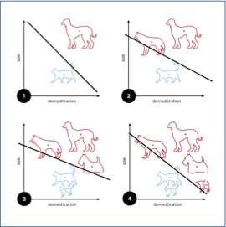
Classification

Slide 22
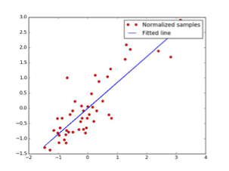
Regression

Slide 23
Regression

Slide 24
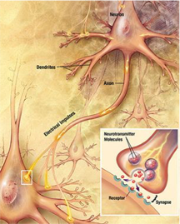
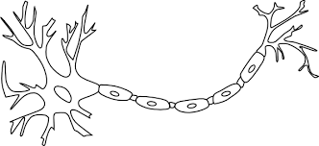
Neural Networks
A primer on neural networks
0.1

Slide 25
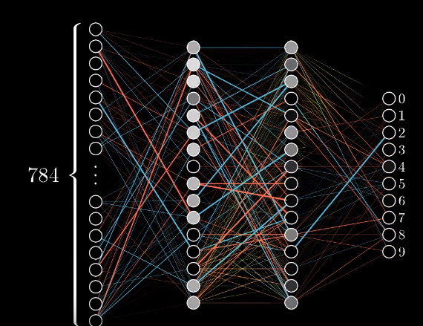
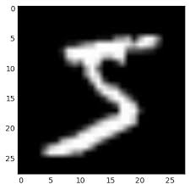
A multi-layer perceptron

Slide 26
Why the layers
It’s a 5!

Slide 27
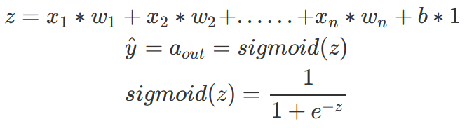
Biases, weights and Sigmoid

Slide 28
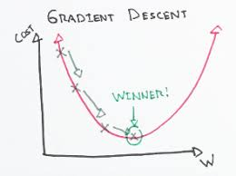
Gradient Descent
(0.3-0)² +(0.9-0)² +(0.5-0)² +(0.4-0)² +(0.9-0)²+ (0.43-1)² +(0.9-0)² +(0.5-0)² +(0.8-0)² +(0.1-0)² +(0.2-0)² +(0.6-0)²+(0.9-0)^{2.}

Slide 29
Backpropagation

Slide 30
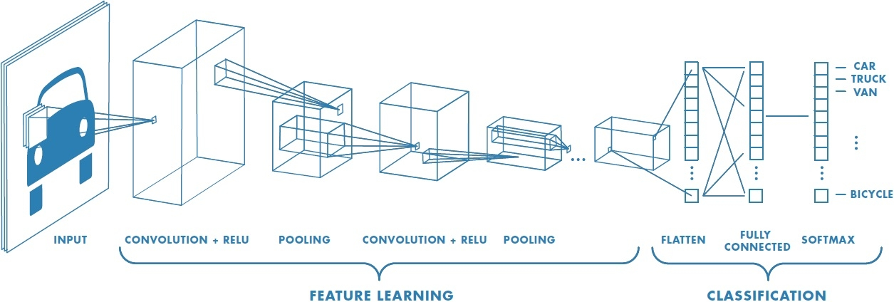
Convolution Neural Networks
Major Components of a CNN
Convolution Layer
Non-linear layer
Pooling layer
Full Connected layer
Output layer

Slide 31

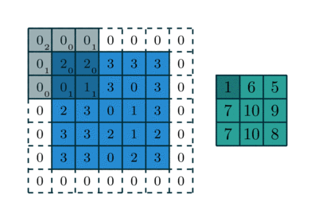
Convolution Neural Networks
Parameters of Convolution Layer:
Input Shape: The shape of the data that will flow into the first layer of the model.
Kernel Size: The size of the sliding convolutional filter windows to be applied to the input data.
Filters:The number of filter windows of size kernelSize to apply to the input data.
Strides:The "step size" of the sliding window.

Slide 32
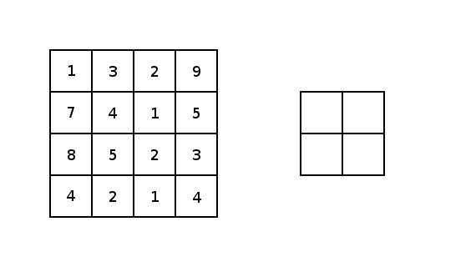
CNN - Max Pooling
Apply a filter and take the max value from that receptive field. After we know we know the specific feature, the exact location of feature is not as important as location of other features.
Pool Size = The size of the sliding pooling windows to be applied to the input data.
Strides = The "step size" of the sliding pooling window

Slide 33
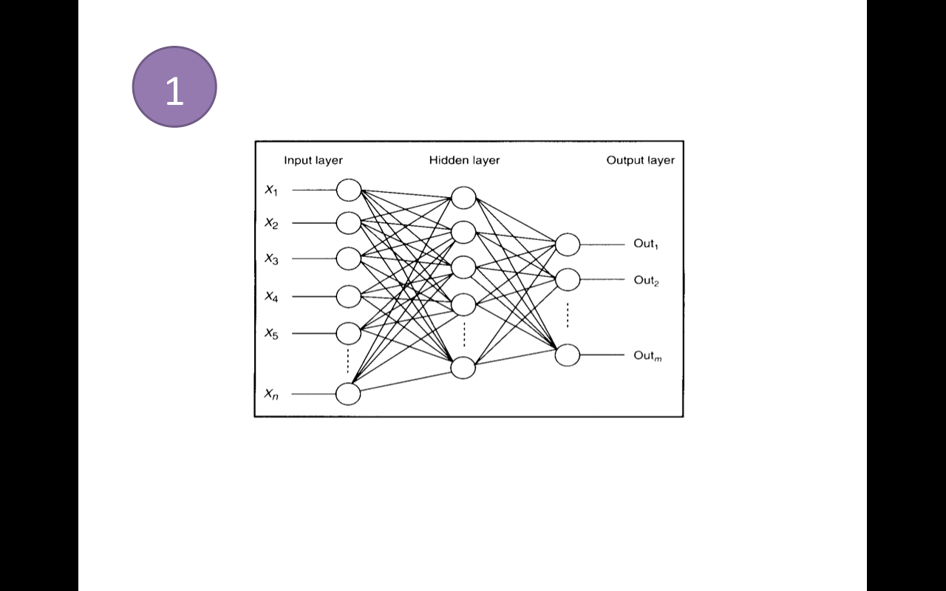
CNN - Fully Connected Layer
Outputs the probability of the image being in any of the N classes. For example in case of MNIST dataset, it will be a 10 x 1 vector.
This works by taking output of previous layer and checking the correlation which each of the class.
Output
The neural network outputs a class label

Slide 34
Thank You!

